Slide 1

We Engineer your Digital Success
Task Management System
Feb 2017
© 2017. All Rights Reserved / www.verbat.com

Slide 2

Contents
1
Background
2
Project Scope
3
Technology Specification
4
Project Timeline & Deliverables
5
Commercials
6
Assumptions & Out of scope
7
Terms & Conditions

Slide 3
Background & Scope

Slide 4
Background
The client has contacted Verbat Technologies to develop a ASP.net based Intranet application for managing the process’ within the organization. The proposed application will be a Task Management Software that assists in the dissemination of large blocks of work into manageable pieces by enabling team members to Create, Plan & Collaborate with each other.
Client had indicated to Verbat that they would like to incorporate features from some of the leading project management applications available in the market. Verbat has taken cues from some mainstream products available in the market to develop a best of the breed application.
To manage the development of the application, Verbat will split the development into three phases, with the objective of delivering a minimum viable project in Phase 1 followed by an incremental approach to deliver the complete product.

Slide 5
Project Scope
The main features of the application are listed below
Create
Create High Level Tasks (Projects, Folders, Tasks & SubTasks)
Request forms to initiate work
File management
Plan
Resource management
Time Tracking
Gant Charts

Slide 6
Project Scope
Verbat shall develop the Intranet portal with the following features:
Homepage ( Submit form, Book Meeting Room, Find Staff, Login )
Company Page (Company Profile, Management Team, Departments, Location )
Human Resources ( About HR, HR Policy Manual, New Employee Induction, Staff Feedback, HR Team)
Information Technology (About IT, IT Policy Manual, Training Videos, Staff Contact, IT Team)
Resources (Company Policies, Document Library, Photo Gallery)
My Content (Notifications, Online Forms, HR Forms, My Profile )
Coffee Break/ Social Collaboration.
In-focus (E-Magazine, Upload Picture, Post Vacation/ Team Trip Picture)
Admin (Manage Users & permission, Manage Company, Manage Human Resources, Manage Information Technology, Manage Resources, Manage Infocus magazine, Manage My Contents)
Yammer integration, Office365 integration

Slide 7
Technology Specification

Slide 8
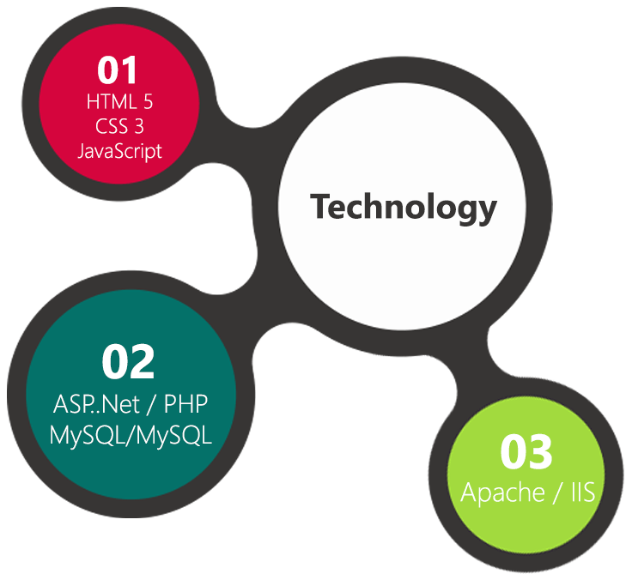
Technology Specifications
Technology Stack
Language : ASP.net or PHP
Database – My SQL or MSSQL
Server – Apache or IIS
Operating System – Linux or Windows
Hosting (Intranet)
4 core CPU
12 GB RAM
HDD: 250 GB
OS/Software: Based on finalized Technology

Slide 9
Project Timeline & Deliverables

Slide 10
Project Timeline & Deliverables
The time estimated for delivering the application is 45 working man days
Activity | Effort | Effort Total (Man Days)
Prototyping
Theme purchase, customization & running prototype | 12 | 89
Development
Admin Module | 10
Home page and User Logins | 9
Company, Human Resources, Information Technology, Resources, My contents & InFocus magazine | 36
QA &UAT
Quality Analysis (QA), UAT, Support, Implementation & Go live | 22
Deliverables
Selection & Purchase of Template
Running Prototype
Test Content Upload
Fully developed and tested Portal for deployment
* See Assumptions for exclusions

Slide 11
Commercials

Slide 12
Commercials
Sl. | Description | Cost
01. | Development of ASP.Net / PHP based Intranet Portal integrated with Yammer and Office365 | AED 0,000

Slide 13
Assumptions & Out of Scope

Slide 14
Assumptions
Intranet Portal shall be done using purchased Template. Verbat shall purchase the template, agreed and signed off by the client
Client shall provide licensed images in specified size & format
Client shall provide the branding guidelines
Client shall provide the necessary server for hosting, and it shall adhere to the server & hosting specification mentioned in the proposal
Client shall provide remote access to the server for installation
Estimate does not include
Form Submission
Book meeting room, Find staff, New employee induction
Leave application, Business trip advice, Expense claim, Passport release
English will be the only language supported
PHP implementation will not support single sign on

Slide 15
Out of Scope
Any language other than English
Database migration
Physical deployment at client’s site
Backup solution and Disaster recovery for hosting
No Emails with the hosting
Content writing
Annual Maintenance Contract
Theme customization (Layout & Element Placements)

Slide 16
Terms & Conditions

Slide 17
Terms & Conditions
Offer Valid for 30 calendar days from the date of submission of the Proposal
An average of 20 working days are assumed in a month
This proposal and all technical/ functional specifications have been derived or concluded from the data shared via email / information's transferred during the initial requirement analysis meetings and conversations. Verbat reserves the right to amend the terms of this proposal, should the SOW terms, functional features and functionalities change during the course of the project
The intranet portal will be built as per the specifications agreed mutually. Any changes will be executed through a deﬁned change management process between both parties
All Source Code and other project artefacts would adhere to the Verbat document templates and internal coding standards
Acceptance criteria will be based on the clauses which were mutually discussed between Verbat and client at the Requirement Analysis phase and the same will be documented and approved by both parties through official emails
Verbat will provide a bug ﬁx warranty at no additional cost for 30 days from the date of acceptance of the project, for correction of any errors in the developed application that may be attributed to Verbat
Final deployment to Live server pursuant to completion of all payments

Slide 18



Contact Us
217, Sheikh Rashid Bldg
P.O Box 56272, Dubai United Arab Emirates
+971 04 2973236
Joyce.daniel@verbat.com
USA 2033 Gateway Place
Suite 500
San Jose , CA- 95110
India
Level 3, PTC Tower
Nanthancode Trivandrum, Kerala

Slide 19

Thank You
© 2017. All Rights Reserved Verbanet Technologies LLC www.verbat.com

